Slide 1
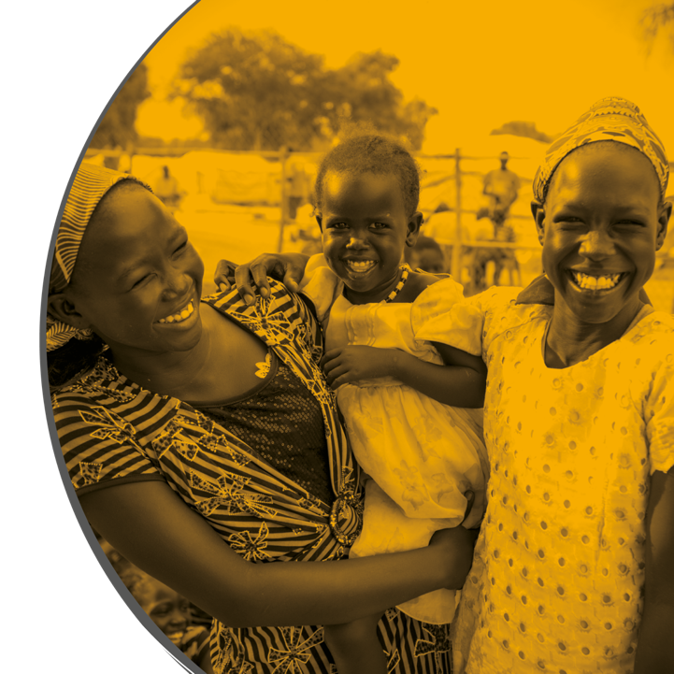
WHERE ARE WE NOW?
What are the big risks and big opportunities
for children?
Prof. Lorraine Sherr & Prof. Lucie Cluver
COALITION FOR CHILDREN AFFECTED BY AIDS
ANNUAL MEETING 2021
With thanks for invaluable thinking by: Prof Linda Richter, Lynette Mudekunye, Prof Kate Powis, Prof Elaine Abrams, Corinna Csaky, Theresa Wolters, Isacc Lekdyang, Miriam Hasasha, Catherine Connor, Dephin Mpofu, Felicia Wong
Notes:
Revise AGYW

Slide 2
SNAPSHOT OF THE CURRENT HORIZON…
RISKS
COVID-19 shadow effect
Teen pregnancy
Access to treatments
Access to prevention
School disruption
Economic ramifications
Loss
Funding decreasing
Treatment dominance at the expense of psychosocial and mental health.
AIDS Weariness
Data desert – went virtual or paused/cut and pay a price
HEU exposed to ART via PrEP – undocumented and untracked (drug resistance).
OPPORTUNITIES
Adolescent agency
World attention (mental health, adolescents, ECD)
Integration – Keeping child affected by HIV at the core of integration. Challenge to design integration to highlight the child rather than lose the child in the mist.
Social Protection
COVID broadened scope (sanitation, water, violence, climate, environment).
Growing evidence base
…LEADING TO 15 TOPICS

Slide 3
1
ADOLESCENT PREGNANCY

Slide 4
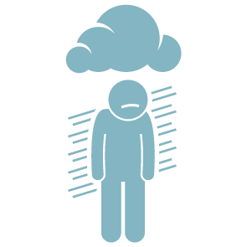
ADOLESCENT PREGNANCY
MW
1.4 million unplanned pregnancies (UNFPA, 2021)
Roberts et al 2021 AIDS & Behavior)
Notes:
Elevated among adolescent mothers
And when we disaggregate further by HIV status (4 groups)

Slide 5
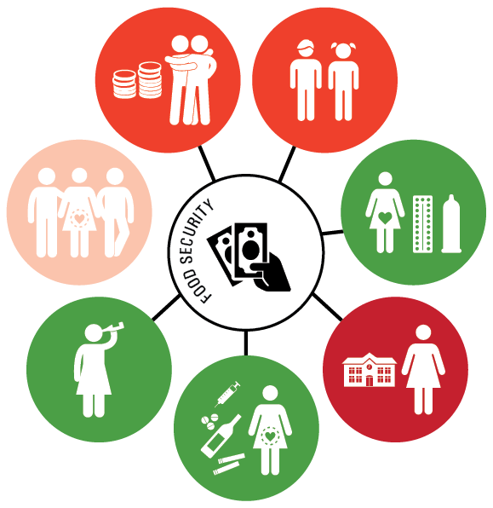
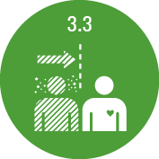
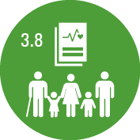
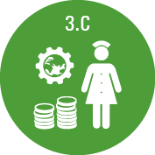
NEW DATA ON SOLUTIONS FOR ADOLESCENT MOTHERS
Adherence to ART
+28.0%
(11.8% → 44.2%)
No missed clinic appointments
+20.8%
(5.1% → 35.4%)
Transactional sex
0.19% 0.4%
95% CI -0.15 (-0.2; -0.1)
Age-disparate sex
0.3 % 0.22%
95% CI -0.08 (-0.14; -0.02)
Unprotected sex
0.72 % 063%
95% CI -0.08 (-0.15; -0.02)
Multiple sexual partners
Alcohol
0.1% 0.05%
95% CI -0.05 (-0.09; -0.01)
School non-enrollment
0.56 % 0.45%
95% CI -0.11 (-0.17; -0.05)
Sex on substances
0.15 % 0.5%
95% CI -0.09 (-0.14; -0.05)
No treatment interruptions
+30.3%
(14.3% → 46.3%)
No TB
+12.7%
(1.3% → 24.1%)
Cluver*, Rudgard* (joint first author), Orkin, Toska et al (in progress)
Toska, Zhou, Laurenzi, Saal & Cluver (analyses in progress)

Slide 6
FIRST UNDERSTANDING OF THE 3RD GENERATION OF HIV-INFECTED EXPOSED CHILDREN
2

Slide 7
FIRST UNDERSTANDING OF THE 3RD GENERATION OF HIV-INFECTED EXPOSED CHILDREN
PERINATALLY INFECTED
more chronic adversity
parental and/or sibling illness and death
caretaking responsibilities
poorer parenting
less social support
internalized and associative stigma
higher risk for lower well-being and higher substance use
Allen et al., 2014; Bailey, Cruz, Songtaweesin, & Puthanakit, 2017; Earnshaw, Kidman, & Violari, 2018; Le Croix et al., 2017; Lowenthal et al., 2014; Rochat, Netsi, Redinger, & Stein, 2017; Sherr et al., 2018).
RECENTLY INFECTED
more likely members of marginalized groups
struggle with impacts of recent diagnoses
difficulties accessing and engaging in care
May be compounded by mental health problems
Anderson et al., 2010; Bailey et al., 2017; Ramirez-Avila et al., 2012; Sherr et al., 2018).

Slide 8
HEY BABY SAMPLE (n= 1046 adolescent mothers)
Application of Logic Tree for Mode of Maternal HIV Acquisition
n= 31 excluded > 68 months
2.7%
26.0%
71.3%
Mother perinatally infected with HIV (n= 27) )
Mother infected with HIV as an adolescent (n= 268)
Mother not living with HIV
(n= 726)
The “Third Generation”
(n = 1 living with HIV)
The “Second Generation” (n = 11 living with HIV)
HIV Unexposed Children (none living with HIV)
Comparison:
1) Child demographics, developmental outcomes
2) Maternal factors (demographics, poverty, mental health, social and HIV – related variables)
Haag et al 2021
Notes:
All live in a challenging environment

Slide 9
 | Overall (N=1015) | Third Generation (n= 27) | Second Generation (n= 264) | No HIV Exposure (n= 724) | p-value
Age at Pregnancy (M, SD) | 16.76 (1.70) | 17.26 (1.99) | 17.84 (1.90) | 16.34 (1.42) | <.001
Paternal Age at Pregnancy (M, SD) | 21.13 (3.89) | 21.32 (4.25)ª | 23.17 (4.08)^{b} | 20.40 (3.54) | <.001
School Grade Repeated | 581 (60.8%) | 16 (61.5%) | 169 (69.3%) | 396 (57.8%) | .007
Depression Score (0-20) | .71 (1.42) | .30 (.67) | .96 (1.72)^{b} | .64 (1.30) | .002
Anxiety score (0-14) | .75 (1.88) | .74 (1.58) | .62 (1.92) | .80 (1.88) | .41
PTSD score (0-36) | 3.01 (5.60) | 1.96 (4.93) | 3.55 (5.60) | 2.86 (4.94) | .09
Suicidality Score (0-5) | .18 (.80) | .07 (.27) | .30 (1.08)^{b} | .14 (.67) | .017
Children of the third generation appear to perform similarly to those not affected by HIV
Families may profit from efforts to provide social protection, links to services and ART – chronic adversity not perpetuated?
Children of the second generation appear to struggle the most - shock of recent diagnosis, compounded by risk factors

Slide 10
COGNITIVE DEVELOPMENT
Well established cognitive impacts for HIV and HEU. (McHenry systematic review and meta-analysis)
McHenry MS, McAteer CI, Oyungu E, McDonald BC, Bosma CB, Mpofu PB, Deathe AR, Vreeman RC. Neurodevelopment in Young Children Born to HIV-Infected Mothers: A Meta-analysis. Pediatrics. 2018 Feb;141(2):e20172888.
Notes:
Vouchers (e-transfers) and nutritional supplements sent to households where a child or pregnant woman was living with HIV

Slide 11
HIV-EXPOSED UNINFECTED CHILDREN
4

Slide 12
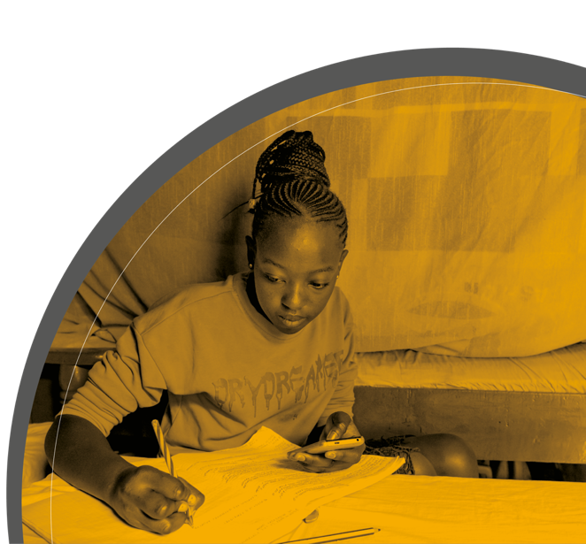
HIV-EXPOSED UNINFECTED CHILDREN
SRH access
Family lens
 | Early Learning composite score
HIV unexposed Uninfected (n=720) | Ref.
HIV-exposed uninfected (n=189) | -2.84 (-6.24, 0.54)
HIV-infected (n=11) | -21.1 (-33.7, -8.46)*
Roberts et al 2021

Slide 13
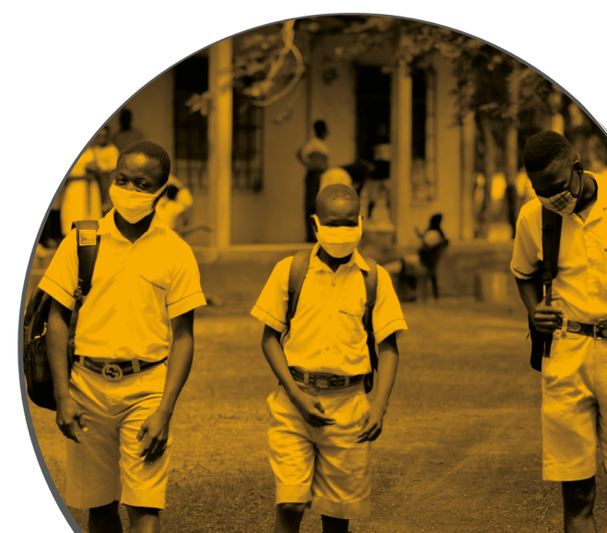
SCHOOL FUNCTIONING
Systematic review / 32 studies, more problems in various areas of school functioning vs national norms, matched controls, siblings and HEU.
Siblings/HEU children also reported significantly worse outcomes compared to national norms.
This suggests that problems in school functioning cannot be solely attributed to the HIV-infection, but that multiple socio-economic and cultural factors may play a role.
van Opstal SEM, Wagener MN, Miedema HS, Utens EMWJ, Aarsen FK, van der Knaap LC, van Gorp ECM, van Rossum AMC, Roelofs PDDM. School functioning of children with perinatal HIV-infection in high-income countries: A systematic review. PLoS One. 2021 Jun 4;16(6):e0252746.

Slide 14
5
MENTAL HEALTH

Slide 15
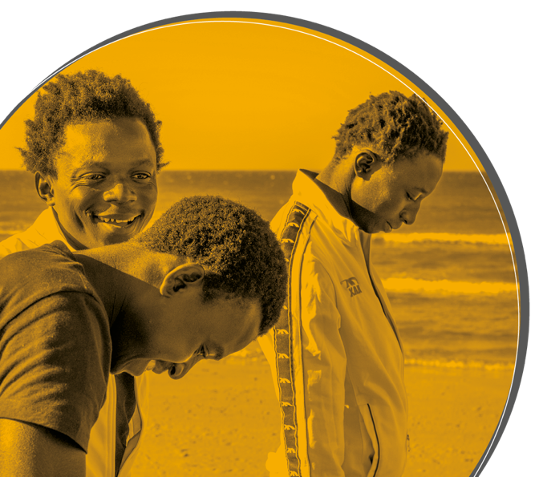
MENTAL HEALTH
Suicidal risk – Kreniske et al 2021 (n=339) Kreniske P, Mellins CA, Dolezal C, Morrison C, Shea E, Fisher PW, Kluisza L, Robbins RN, Nguyen N, Leu CS, Wiznia A, Abrams EJ. Predictors of attempted suicide among youth living with perinatal HIV infection and perinatal HIV exposed uninfected counterparts. J Acquir Immune Defic Syndr. 2021 Aug 16.
Attempted suicide prevalence significantly higher among Adolescents living with HIV compared to Adolescents HEU (27% vs 16%, p = 0.019) with HIV having 2.21 times the odds of making an attempt (95% CI: [1.18, 4.12], p = 0.013).
Rukondo (2020) n=392 Uganda. 10.7% prevalence among youth HIV. Rukundo GZ, Mpango RS, Ssembajjwe W, Gadow KD, Patel V, Kinyanda E. Prevalence and risk factors for youth suicidality among perinatally infected youths living with HIV/AIDS in Uganda: the CHAKA study. Child Adolesc Psychiatry Ment Health. 2020 Oct 24;14:41.

Slide 16
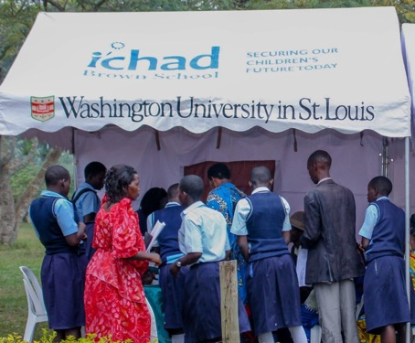
INNOVATIONS IN EVIDENCE: Mental health & HIV
ZIMBABWE
Zvandiri + Friendship bench = viral suppression + mental health benefits
UGANDA
Suubi+adherence – economic support = viral suppression + mental health benefits
Simms et al (in press) PLOS Medicine. Mavhu et al (2020) Lancet Global Health. 8. 2 e264-e275. Chibanda et al (2016) JAMA. 316. 24. 2618-2626.
Ssewamala, F. M et al (2020). PLoS One 15(2): e0228370.
Cavazos-Rehg, P et al (2021). J Adolesc Health 68(4): 742-749.

Slide 17
6
COVID INCREASED RISKS

Slide 18
COVID INCREASING RISKS
140
80
6+15
800
1.4
million children
million infants
million children
million children
million
Additionally pushed into extreme poverty (UNICEF, 2021)
Will miss routine immunisation
(UNICEF 2021)
Experience loss of care giver (Hillis, Lancet 2021)
Still fully or partially closed schools
(UNESCO, 2021)
Unplanned pregnancies
(UNFPA, 2021)
Service interruption, service closure, long-term funding removal
Notes:
Even before the pandemic AGYW have been a population of concern particularly in sub-Saharan African where women and girls accounted for 59% of all new HIV infections and , five in six new infections among adolescents aged 15–19 years are among girls.
COVID pandemic has increased the HIV infection risk faced by girls and young women, These projections from World Bank and UNFPA show how COVID is negatively impacting on poverty, child marriage, gender based violence access to education and to contraception including condoms – all of which are factors which place adolescent girls at heightened risk of HIV infeciton
We are also seeing increased risk of gender-based violence In some regions- - which is a particular concern as women facing physical or sexual intimate partner violence are 1.5 times more likely to acquire HIV than women who have not experienced such violence.
https://www.worldbank.org/en/news/immersive-story/2021/01/22/urgent-effective-action-required-to-quell-the-impact-of-covid-19-on-education-worldwide World Bank
https://www.unfpa.org/sites/default/files/resource-pdf/COVID-19_impact_brief_for_UNFPA_24_April_2020_1.pdf

Slide 19
7
CAREGIVER LOSS

Slide 20
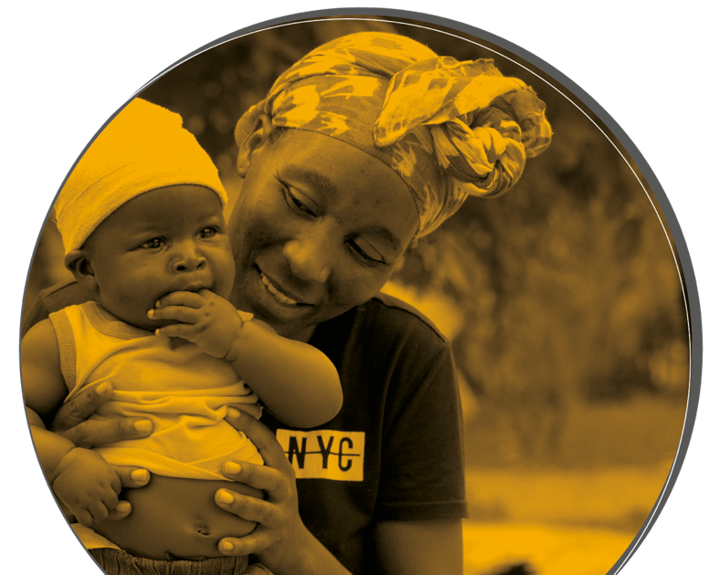
CAREGIVER LOSS
Orphan issue – Double impact – High impact HIV countries also impacted by COVID caregiver loss.
Grief intervention (Thurman et al), and complicated grief as an issue Thurman TR, Taylor TM, Luckett B, Spyrelis A, Nice J. Complicated grief and caregiving correlates among bereaved adolescent girls in South Africa. J Adolesc. 2018 Jan;62:82-86.
COVID-19 6.7 Million children have lost a primary caregiver so far (Hillis et al 2021) and 15 Million children have lost a parent to HIV/AIDS Hillis SD, Unwin HJT, Chen Y, Cluver L, Sherr L, Goldman PS, Ratmann O, Donnelly CA, Bhatt S, Villaveces A, Butchart A, Bachman G, Rawlings L, Green P, Nelson CA 3rd, Flaxman S. Global minimum estimates of children affected by COVID-19-associated orphanhood and deaths of caregivers: a modelling study. Lancet. 2021 Jul 31;398(10298):391-402.
UNAIDS 2021 estimates.

Slide 21
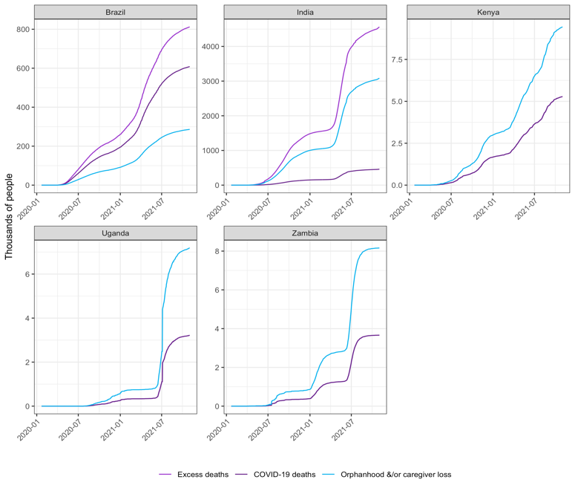
ORPHANHOOD IN KEY AREAS FOR AIDS-AFFECTED CHILDREN

Slide 22
OPPORTUNITIES
Notes:
Zim – violence and food insecurity (Madison)
Another combination re. cash and …
Need to base this on existing models -
A few accelerator models as examples (before this slide). Are there others/ potentials?
Malawi food and school health
Mozambique – food nutrition education and SRHR services
Cash and food –

Slide 23
8
POVERTY – SOCIAL PROTECTION

Slide 24
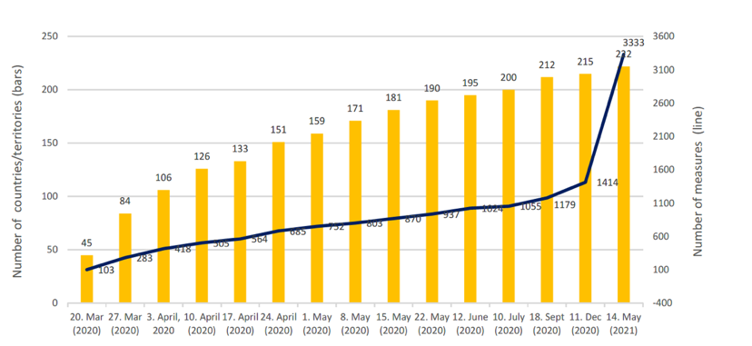
POVERTY – SOCIAL PROTECTION
Cash plus care – WB review
Combining Cash with Psychosocial interventions reduction in HIV incidence. (Stoner et al).
Evolution in number of countries/territories and social protection measures
Stoner MCD, Edwards JK, Westreich D, Kilburn K, Ahern J, Lippman SA, Gómez-Olivé FX, Kahn K, Pettifor A. Modeling Cash Plus Other Psychosocial and Structural Interventions to Prevent HIV Among Adolescent Girls and Young Women in South Africa (HPTN 068). AIDS Behav. 2021 Jan 21:10.1007/s10461-021-03158-3.

Slide 25
9
HIV + COVID MULTI-SOLVERS

Slide 26
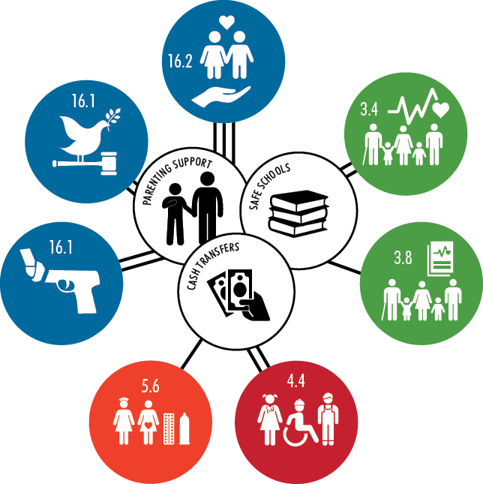
HIV+COVID MULTI-SOLVERS
No Abuse
+51%
Adolescents living with HIV (n=1000)
South Africa
No community violence
+20%
Good mental health
+33%
No violence perpetration
+34%
HIV care retention
+22%
No high-risk sex
+19%
School progression
+34%
Cluver, Orkin, Toska, Campeau, Webb, Carlqvist, Sherr, (2019) Lancet CAH

Slide 27
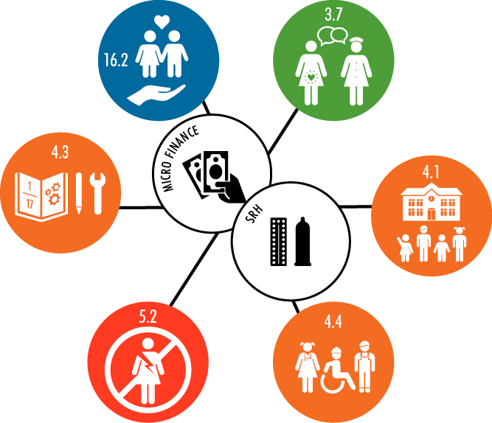
HIV+COVID MULTI-SOLVERS
Adolescent girls
Sierra Leone
Unwanted sex
Contraception
School enrolment
Learning time
Sexual exploitation
Literacy & numeracy
Bandiera, Buehren, Goldstein, Rasul, Smurra, (2018) World Bank Ebola, Sierra Leone

Slide 28
10
INTERGENERATIONAL IDEAS

Slide 29
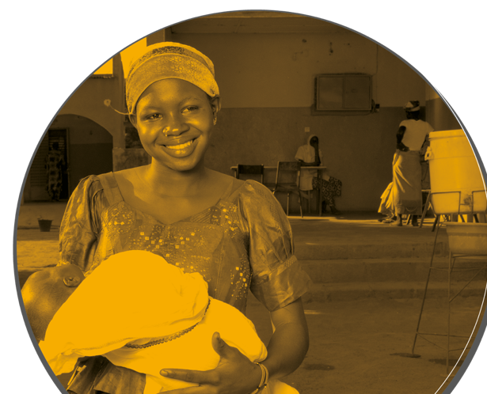
INTERGENERATIONAL IDEAS
Maternal ACE associated with poorer socioemotional development. Long term effects of childhood adversity (direct or via increased depression in the mother as an adult). Brittain K, Zerbe A, Phillips TK, Gomba Y, Mellins CA, Myer L, Abrams EJ. Impact of adverse childhood experiences on women's psychosocial and HIV-related outcomes and early child development in their offspring. Glob Public Health. 2021 Oct 6:1-13

Slide 30
11
DISCLOSURE

Slide 31
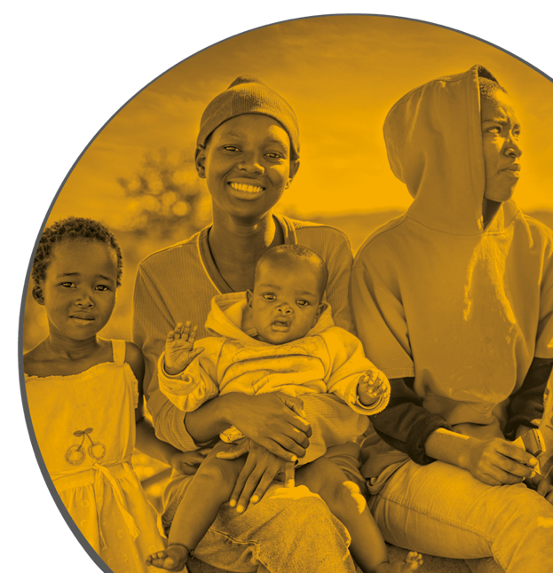
DISCLOSURE
Disclosure does not worsen the child’s emotional health, wellbeing or adherence to art . 18 month follow up study Buckley J, Otwombe K, Joyce C, Leshabane G, Galvin L, Ramsammy C, Lebotsa ME, Liberty A, Violari A. Impact of Disclosure over Time on the Emotional Well-Being of Children with Perinatally Acquired HIV Infection in South Africa. J Dev Behav Pediatr. 2021 Sep 24.
Non Disclosure risk for HIV virological non suppression among adolescents – Zimbabwe study n-842, 35.1% non suppressed. Similar findings in Ghana (Afrane et al 2021) n=250 Simms V, Bernays S, Chibanda D, Chinoda S, Mutsinze A, Beji-Chauke R, Mugurungi O, Apollo T, Sithole D, Verhey R, Weiss HA, Willis N. Risk factors for HIV virological non-suppression among adolescents with common mental disorder symptoms in Zimbabwe: a cross-sectional study. J Int AIDS Soc. 2021 Aug;24(8):e25773.

Slide 32
12
ADHERENCE

Slide 33
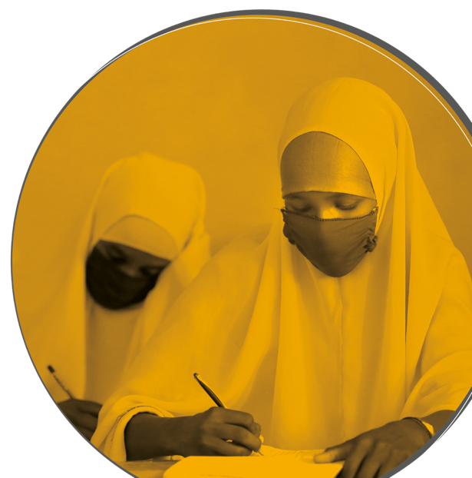
ADHERENCE
Predicting risk of poor adherence Brathwaite R, Ssewamala FM, Neilands TB, Okumu M, Mutumba M, Damulira C, Nabunya P, Kizito S, Sensoy Bahar O, Mellins CA, McKay MM. Predicting the individualized risk of poor adherence to ART medication among adolescents living with HIV in Uganda: the Suubi+Adherence study. J Int AIDS Soc. 2021 Jun;24(6):e25756.
Non adherence drivers? High 33.8% non adherent (Cameroon study) Lantche MW, Fokam J, Cheudjui AJN, Tchatchueng JBM, Noumsi TSJ, Ateba FN, Koki PN, Billong CS. Factors associated with non-adherence to antiretroviral therapy among HIV-infected adolescents aged 15-19 years: a snapshot from the Mother and Child Center in Yaounde, Cameroon. Pan Afr Med J. 2021 Jun 29;39:154.
Interventions with evidence base – Text message 5/7 studies showed effect – overall still needs analysis (lots of issues eg phone access) Mehra N, Tunje A, Hallström IK, Jerene D. Effectiveness of mobile phone text message reminder interventions to improve adherence to antiretroviral therapy among adolescents living with HIV: A systematic review and meta-analysis. PLoS One. 2021 Jul 22;16(7):e0254890.

Slide 34
13
INTEGRATION

Slide 35
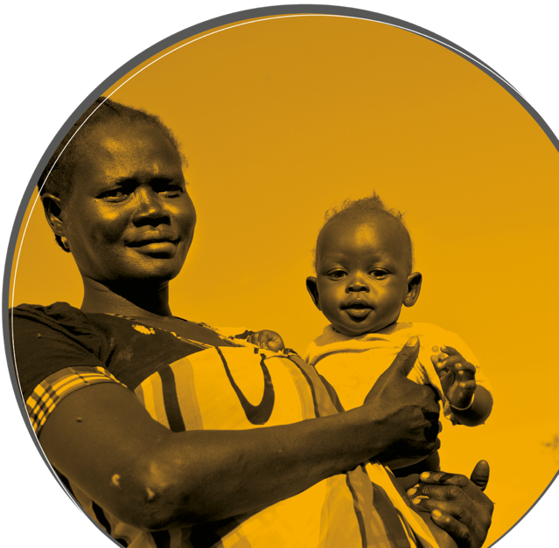
INTEGRATION
Richter Kenya – Mental health
Malawi (Dovel et al) Integrating ECD into PMTCT Services. Redinger S, Udedi E, Richter LM, Dovel KL, Bruns L, Coates TJ, Rochat TJ. Double benefit? Integrating an early childhood development programme into HIV PMTCT Option B+ services in Malawi. AIDS Care. 2021 Feb 22:1-8.
Lancet series – integrating mental health into HIV care
Maternal HIV – models impacts on child eg School drop out 4x Desmond C, Labuschagne P, Cluver L, Tomlinson M, Richter L, Hunt X, Marlow M, Welte A. Modelling the impact of maternal HIV on uninfected children: correcting current estimates. AIDS Care. 2020 Nov;32(11):1406-1414.
Embedding implementation into child health and nutrition programming Jackson D, Shahabuddin ASM, Sharkey AB, Källander K, Muñiz M, Mwamba R, Nyankesha E, Scherpbier RW, Hasman A, Balarajan Y, Albright K, Idele P, Peterson SS. Closing the know-do gap for child health: UNICEF's experiences from embedding implementation research in child health and nutrition programming. Implement Sci Commun. 2021 Sep 29;2(1):112

Slide 36
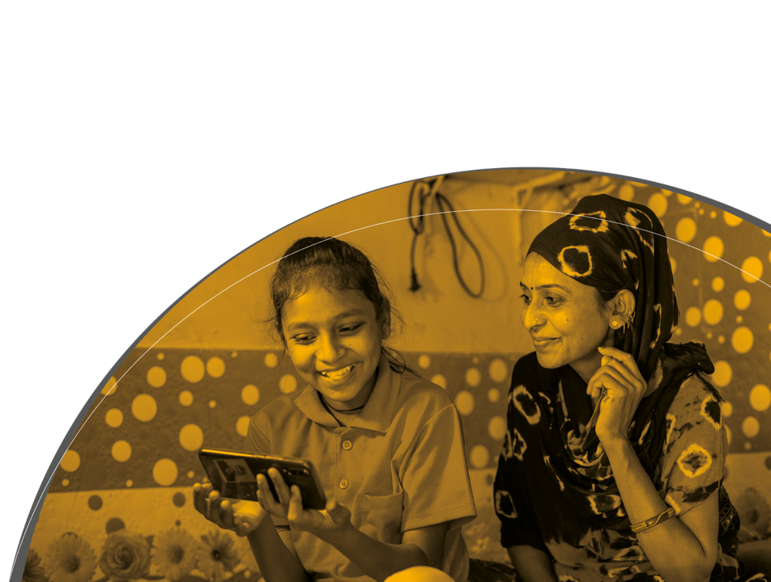
TECHNOLOGY
Digital divide
Importance of access, technology heightened by COVID
Opportunity and a risk – online bullying
Increase mode of delivery, eg Parenting app, support, education
Opportunities to bundle services

Slide 37
14
RISK

Slide 38
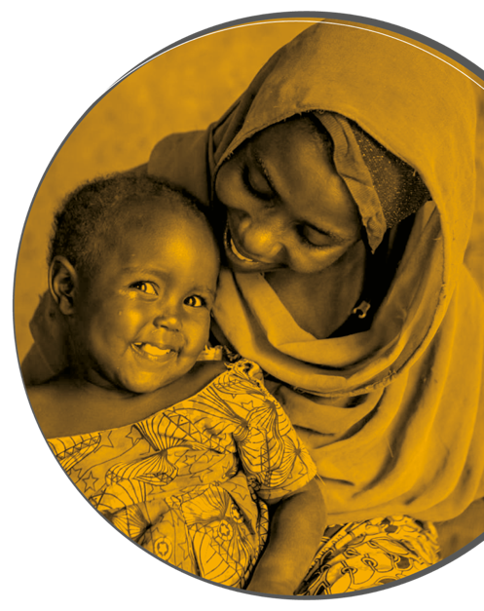
RISK
Prep and PEP studies, issues of availability, acceptability, disclosure, uptake Giovenco D, Pettifor A, Powers KA, Hightow-Weidman L, Pence BW, Edwards JK, Gill K, Morton JF, van der Straten A, Celum C, Bekker LG. The Effect of PrEP Use Disclosure on Adherence in a Cohort of Adolescent Girls and Young Women in South Africa. AIDS Behav. 2021 Sep 3. Dettinger JC, Pintye J, Dollah A, Awuor M, Abuna F, Lagat H, Kohler P, John-Stewart G, O'Malley G, Kinuthia J, Beima-Sofie K. "What is this PrEP?"- Sources and accuracy of HIV Pre-Exposure Prophylaxis (PrEP) awareness among adolescent girls and young women attending family planning and maternal child health clinics in Western Kenya. J Acquir Immune Defic Syndr. 2021 Aug 9.
High awareness yet low uptake – Kenya “Most AGYW (89%) had previously heard of PrEP; 76% had at least one PrEP eligibility criterion as per national guidelines; however, only 4% initiated PrEP” Sila J, Larsen AM, Kinuthia J, Owiti G, Abuna F, Kohler PK, John-Stewart G, Pintye J. High Awareness, Yet Low Uptake, of Pre-Exposure Prophylaxis Among Adolescent Girls and Young Women Within Family Planning Clinics in Kenya. AIDS Patient Care STDS. 2020 Aug;34(8):336-343.
Sexual risk behaviour
Drug, substance and alcohol use
Violence and abuse
School based interventions Shangase N, Kharsany ABM, Ntombela NP, Pettifor A, McKinnon LR. A Systematic Review of Randomized Controlled Trials of School Based Interventions on Sexual Risk Behaviors and Sexually Transmitted Infections Among Young Adolescents in Sub-Saharan Africa. AIDS Behav. 2021 Mar 27

Slide 39
15
PARENTING

Slide 40
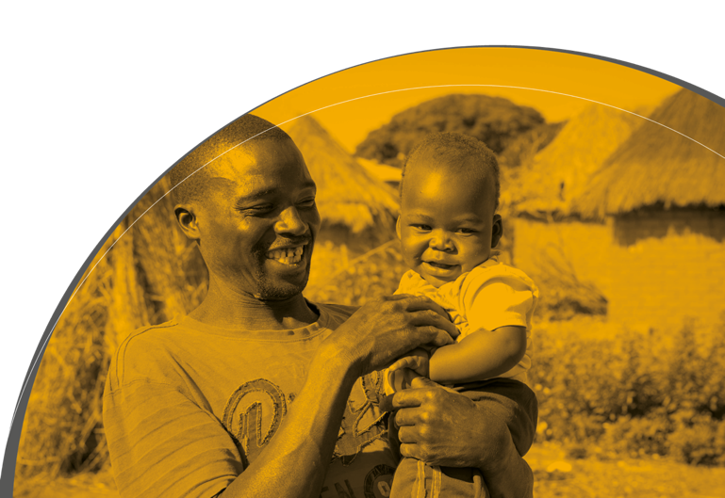
PARENTING
Fathers
Growing acknowledgement of the importance of fathers
Nurturing care
Implications of the Nurturing care framework
Widely circulated
Adoption Black MM, Behrman JR, Daelmans B, Prado EL, Richter L, Tomlinson M, Trude ACB, Wertlieb D, Wuermli AJ, Yoshikawa H. The principles of Nurturing Care promote human capital and mitigate adversities from preconception through adolescence. BMJ Glob Health. 2021 Apr;6(4):e004436.
Early childhood development and ECD Provision

Slide 41
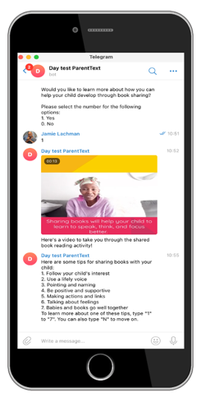
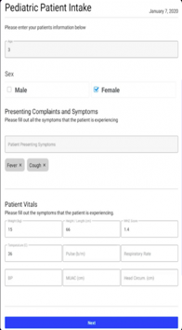
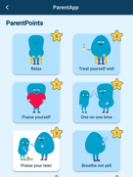
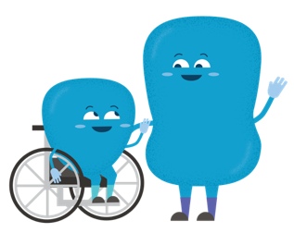
HYBRID HUMAN-DIGITAL COVID ADAPTATION
Elsa: AI-pediatric tool
Text messages
Offline apps

Slide 42
BIG RISKS BIG OPPORTUNITIES
BIG UNKNOWNS
Time for big thinking.
Resources rolled into one
Cost-effectiveness evidence for advocacy
Long-term economic opportunities for children
Crossing the digital divide
Notes:
Growing interest in gender transformative and responsive programmes – how they can address for example increase drop out girls from school at puberty or increasing agency around child marriage and choice of sexual partners GRASSP
Many cases not separate interventions but adapting programs to make them more responsive

Slide 43
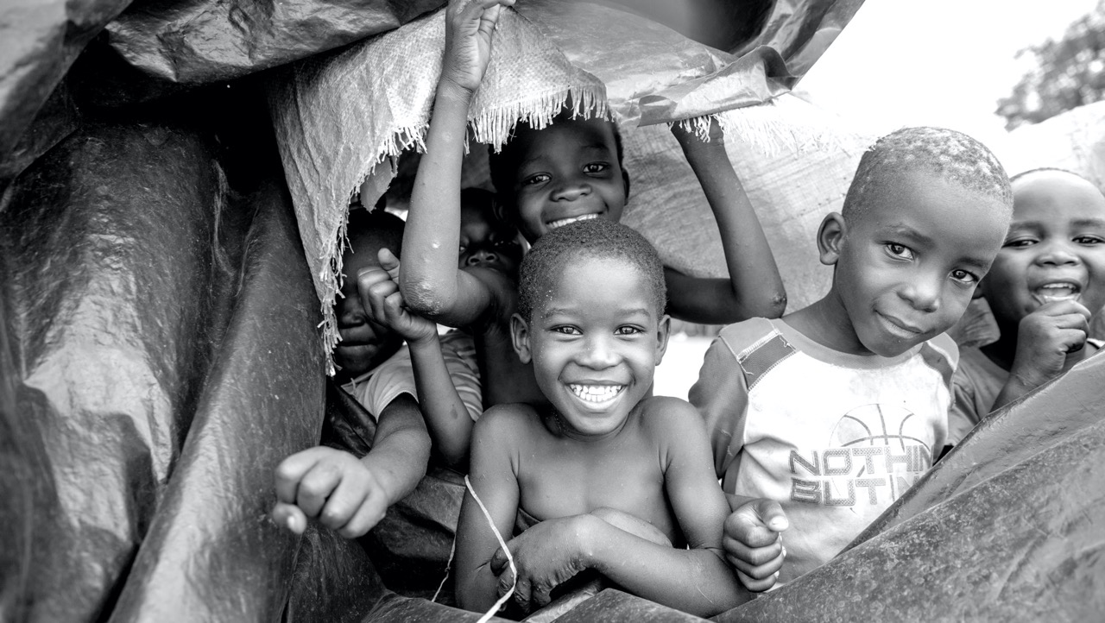
THANK YOU

