Slide 1
Expenditures and Resource Needs to Support Children and Adolescents Affected by HIV and AIDS
John Stover, Peter Stegman
22 February 2023

Slide 2
Purpose
Understand current expenditures on programs for children and adolescents affected by HIV/AIDS
Describe the sources of expenditures
Compare to estimates of the resources needed
Notes:
This presentation will describe the information available on current spending on programs for children and adolescents affected by HIV/AIDS and compare current spending with estimates of the resources needed. We hope that this will help to mobilize additional resources to close the spending gap.

Slide 3
How much is currently spent on programs for children and adolescents?

Slide 4
Public expenditure databases do not provide comprehensive picture
PEPFAR reports expenditures on its Panorama Spotlight Dashboard, but the categories are too broad to identify all spending on children and adolescents. PEPFAR has prepared estimates drawn from budgets and agreed allocation rules
Global Fund only reports in very broad categories. The current reporting system does not support analysis by intervention.

Slide 5
PEPFAR COP 21 Program Budget (0-24) (US$ Millions)
Total 0-24 = $1210 million
Total 0-17 = $818 million
PEPFAR Panorama Spotlight (https://data.pepfar.gov/library, Financial Management, Children and Adolescent Budget
Notes:
OVC support includes all types of support for OVC and their families and could include food, clothing, housing, health care, school fees, etc.
Socio-economic programs could include education assistance, economic strengthening, food and nutrition support, psychosocial support, legal services, human rights and protection
Above-site level expenditures support activities at a district, provincial or national level that do not involve interaction with beneficiaries or activities at the point of service. It could include procurement, training, research, etc. Management refers to program and project support activities including planning, coordinating, evaluating and managing contracts.

Slide 6
UNAIDS Spending Assessments
UNAIDS supports the collection of detailed expenditure information using a national health accounts approach to HIV/AIDS expenditures (National AIDS Spending Assessment – NASA).
Over 100 countries have implemented NASA or provided their own data
Limitations: Not all countries report in all years. Full NASAs are usually done only every 5 years. Spending on social enablers and social protection may not be classified as AIDS expenditures
Source: https://hivfinancial.unaids.org/hivfinancialdashboards.html

Slide 7
Current Expenditures for Children and Adolescents in LMIC
PM
ASL
C&A
OVC
VMMC
ART
PMTCT
AGYW = adolescent girls and young women, ABYM = adolescent boys and young men, STI Tx = treatment of sexually transmitted infections, CSE = comprehensive sexuality education, EE = economic empowerment, VMMC = voluntary medical male circumcision, PMTCT = prevention of mother-to-child transmission, C&A = children and adolescent not disaggregated, ASL = above site level, PM = program management
Notes:
This chart shows the best estimate of total expenditures on programs for children and adolescents in 2020 by intervention type. These are based on the UNAIDS estimates described earlier. The major programs include ART, PMTCT, OVC and VMMC. When we add program management and above site level costs the total comes to about US$ 1.6 billion. This represents about 12% of all HIV/AIDS expenditures. In some categories spending is too small to show in the stacked bar. We will return to this slide later when we look at resource needs.

Slide 8
Distribution of Spending by Source
Source: UNAIDS GARPR16-GAM2021Oct2021
Notes:
These estimates indicate that half of expenditures are from domestic sources, mostly national governments. PEPFAR accounts for about 36% and the Global Fund 8%.

Slide 9
Distribution of Spending by Intervention
Source: UNAIDS GARPR16-GAM2021Oct2021
Notes:
Social protection accounts for the largest share of expenditures. This is mostly support for OVC but may include some other activities as well.
PMTCT accounts for the second largest amount of spending, although it is decreasing as prevalence declines among pregnant women.
Pediatric ART is the third largest component at 19% of the total.
VMMC accounts for the 4th largest amount. Note that this includes only the amount for males under 18, which were about 40% of VMMC recipients in 2020. This may decline in the future as VMMC for children under 15 is not recommended, except for infant circumcision.
For key populations this represents only the amounts for <17 years old, estimated as 7% of the total expenditures.
The category ‘Children and Adolescents’ represent additional expenditures not disaggregate by type of intervention.

Slide 10
Distribution of Spending by Country
Source: UNAIDS GARPR16-GAM2021Oct2021
Notes:
Among reporting countries more than half of all spending for children and adolescents is in 5 countries: Kenya, South Africa, Mexico, Mozambique and Uganda.
As expected, most spending for children occurs in the high burden countries for SSA, however Mexico, Russia, Thailand, India and Haiti are in the top 20.
For Mexico the spending is almost all on PMTCT.
For Russia most spending in on pediatric treatment and PMTCT.
For Thailand two-thirds is for social protection.
For India there is no disaggregation of spending for children and adolescents.

Slide 11
Distribution of Spending by Income Group
Notes:
The pattern of spending varies somewhat by income grouping. The low-income group (26 countries) accounts for 24% of spending. The lower middle income group accounts for 32% with the rest 43% in the upper middle-income group.

Slide 12
How much funding is needed?

Slide 13
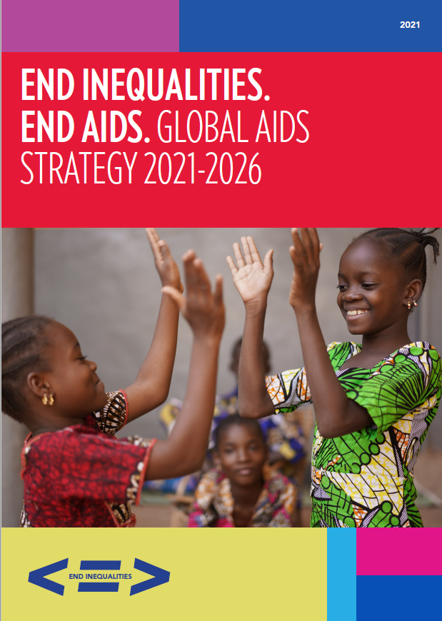
Estimated Resource Needs
UNAIDS Global AIDS Strategy 2021-2026
Establishes targets for 2025 and 2030 for all LMIC by service
Resources needed =
People in need of service
x Coverage
x Unit cost

Slide 14
Current Expenditures in LMIC
AGYW = adolescent girls and young women, ABYM = adolescent boys and young men, STI Tx = treatment of sexually transmitted infections, CSE = comprehensive sexuality education, EE = economic empowerment, VMMC = voluntary medical male circumcision, PMTCT = prevention of mother-to-child transmission, ASL = above site level, PM = program management
Notes:
This chart compares current spending with resources need to achieve the UNAIDS global targets. The total gap is about $820 million.

Slide 15
Is there a funding gap?

Slide 16
ART, PMTCT, EID, VMMC
Clear coverage gap
Additional $160M needed to meet targets at average unit costs
Funding is not the only barrier. There are also health system constraints, demand limitations, difficulties to identify all PLHIV

Slide 17
Key Populations
Clear coverage gap
Additional $410M needed to meet targets at average unit costs
Information on 15–17 age group is limited
Other issues: political will, legal barriers, stigma and discrimination
Source: aidsinfo.unaids.org, UNAIDS Global Strategy 2021-2026

Slide 18
For some services it is hard to quantify the need
Services | Issues
Social protection and services of orphans and vulnerable children Programs for AGYW (DREAMS) | People in need are determined locally No clear packages of services required by each population
Societal enablers Reduce stigma and discrimination Legal reform / decriminalization Prevent gender-based violence | Global need has been estimated Children and adolescents clearly benefit but it is difficult to assign a proportion of total resource need to them

Slide 19
Conclusions
Current expenditures on programs for children and adolescents affected by AIDS are about 12% of total expenditures
Coverage is high for some key services but still short of global targets
Additional expenditures will be needed to meet targets, but other constraints also need to be addressed to benefit from additional funding
For some interventions need is not easily estimated at a global level

