Slide 1
Children & Adolescents:
Closing the Funding Gap
Joint reflections of the Members of the Coalition for Children Affected by AIDS
Presented by Luann Hatane, PATA
CCABA Co-Chair
22nd February 2023
Notes:
Thank you for your participation colleagues. At the Coalition for Children Affected by AIDS are very excited by this research and it contribution to our collective efforts in ending AIDS in children. I would like to echo Corinna in thanking our partners - WHO, UNAIDS and UNICEF, Pefar, the GF and Avenir Health and the many donors, NGOs, academics and members who have shaped this report.
In bringing our meeting to a close I would like to take the opportunity to highlight the collective reflections of the 25 Members of the Coalition for Children Affected by AIDS on these new research findings. These are also available in the report itself and is based on the experience and evidence shared by The Coalition members on what works.

Slide 2
We must not wait.
Change is urgently needed and progress is possible even where funding is scarce. There are things we can all do today to improve financing for children and adolescents.
Notes:
We must not wait. Progress is possible even where funding is scarce. There are things we can all do today, and in the coming months and years to improve financing for children and adolescents. For this prioritization, we urgently need;

Slide 3
1
2
3
Government and donor leadership is vital. It unlocks funding, technical and public support for children and adolescents affected by HIV.
Increase investments in children and adolescents affected by HIV. Ring-fence funds for them and make them a core component of budget requests.
Prioritize investment in cost-effective solutions that target populations ordinarily left behind. E.g. Combining biomedical, mental health, social protection, and early childhood development interventions; design and delivered by frontline health workers, communities, and peers; and advocacy and campaigns that tackle stigma and discrimination against adolescent mothers and the children of key populations.
Prioritize locally led decision making on investments. Shift conventional funding top-down mechanisms and take concrete steps to decolonize funding practices and shift decision making power to countries for increased localization and ownership.
Notes:
Governments and donor leadership must prioritize children and adolescents affected by HIV, especially those affected by poverty and social and structural exclusion. This includes the children of key populations, adolescent parents and their children, and orphans and vulnerable children. These are the populations being left behind.
Reaching these populations and focussing on service delivery and those who deliver services on the frontline will enable us to achieve global HIV targets, the UNs SDGs, and will provide important pathways to UHC.
With new mechanisms like the Global Alliance to end AIDS and the Global Fund’s budget optimization process.we have an opportunity to call for Increased investments and ask for increased ring-fending of funds for them in donor,, national and international budgets.
Within these different funding mechanisms, we are also painfully aware of the inequalities that drive HIV, and in a continent like Africa, we not only suffer disproportionately from Aids, but still remain largely dependent on international funding, with most countries on the continent in debt distress or at risk of it, resulting “impossible-trade-offs” often at the cost of our children.
We also ask our donors to reflect on conventional funding mechanisms, and seek to increasingly improve upon systems and practises that hold countries beholden to plans and processes often made elsewhere, and where valuable community-led response are unable to meet complex, and stringent criteria.

Slide 4
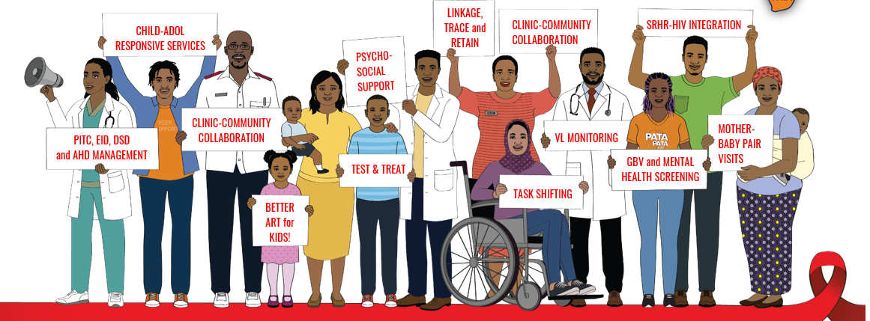
4
5
Plug the financial gaps in the HIV programming portfolio. Early infant diagnosis; self-testing; family-based testing; maternal retesting; ART for older children; prevention for adolescent girls and boys; dolutegravir; long-acting PrEP among pregnant HIV-negative women; longitudinal tracking of mother–baby pairs; and early linkage to treatment and prevention services.
Share costs and align strategies with those seeking stronger systems for health. E.g. pandemic preparedness, universal health coverage, education, gender equality, protection from violence, early childhood development, economic growth.
Notes:
When we know what works in our programming, lets close the funding gaps so these can be scaled - Early infant diagnosis; self-testing; family-based testing; maternal retesting; ART for older children; prevention for adolescent girls and boys; p DTF, advanced HIV disease management for children, long-acting PrEP among pregnant HIV-negative women; longitudinal tracking of mother–baby pairs; and early linkage to treatment and prevention services.
We need to think more about ways we can build stronger and more integrated systems for health, so that funds can be leveraged across programmes that are better aligned. This will help share, and utilise resources more responsibly and effectively. There are opportunities to share core costs across programmes and departments – especially when thinking about pandemic preparedness, universal health coverage, education, economic growth, and other sectors that directly affect children and adolescents affected by HIV.
Investing in inter-sectoral, and clinic-community collaboration is critical. This can build mechanisms to promote and sustain coordination between clinics and community-health services, schools, and other development providers to work together to align strategies and to target excluded children, adolescents, and caregivers with a joined-up package of support, offering social protection, mental health, support for gender equality, protection from violence, early childhood development, and employment opportunities.

Slide 5
6
7
8
Increase the visibility of funding for children and adolescents affected by HIV and the impact it is having. The more detail the better. Knowing the age group, sex, and intervention type helps ensure that money is reaching those who need it most and that it is achieving results.
Strengthen the voices of children, adolescents, caregivers, and those who deliver services, and those who work alongside them in monitoring and making decisions regarding funds. E.g. CCMs; COP processes; thematic government working groups and planning, evaluation and accountability processes.
Research what is happening to children and adolescents and act on it. Incorporate them into data collection and decision-making processes, including PHIA surveys.
Notes:
Let’s Increase the visibility of funding for children and adolescents affected by HIV and the impact it is having. This is vital for sustaining commitment, maintaining accountability, and ensuring value for money, with a focus on children. Let’s develop and support the development of a simple, but unified framework that applies to all countries and donors where we can better track, and know where funds are being spend on children, with much more disaggregation than what we have currently. This detail the better will help us better understand our results in relation to this investment and importantly will help us identify who is not being reached.
Strengthen the voices of children, adolescents, caregivers, and those who deliver services on the frontline in monitoring and decision-making processes. They know best what works, and what does not. We must support their meaningful engagement and participation in Global Fund country coordinating mechanisms, the PEPFAR COP process as well as operational planning processes, thematic working groups under national ministries of health, and the new Global Coalition to end AIDS in Children. With this must come real commitment to building their capacity to engage with confidence, and fully represent the constituents they represent. Let’s also make sure that community led monitoring systems include the voice and experiences of both service users and those who deliver the service.
Research what is happening to children and adolescents and act on it. Data on this population must be incorporated into data collection and must inform decision-making. Greater attention must also be given to on operational research that unlocks barriers in implementation and better documents mechanisms that enhance service delivery to those who need it, in the places where needed most.

Slide 6
What Next?
The Coalition Announces a New Phase of Research into Financing for Children and Adolescents Affected by HIV

Slide 7
The Coalition is embarking on the next phase of research. Over time, we seek to build a fuller picture.
Analyzing, for example, financing from private trusts and foundations, domestic sources, and taking a deep dive into particular countries.
Notes:
This is just the beginning. The Coalition is on a longer journey to improve financing for children and adolescents affected by HIV and we invite you to come along with us. Over time, we seek to build a fuller picture, analyzing, for example, financing from private trusts and foundations and domestic sources, and taking a deep dive into particular countries.
We invite collaboration in the next phase of research. Perhaps you are from a private trust or foundation that wants to unpack private philanthropy for children and adolescents impacted by HIV? Or you are a priority country of the Global Alliance to End AIDS in Children and want to unpack national financing for children and adolescents in more detail? Or you are interested in understanding how to improve financing for holistic service delivery?

Slide 8
The Coalition invites you to collaborate in this next phase.
Contact the Coalition via our website, www.childrenandHIV.org or at info@childrenandHIV.org
Notes:
We are keen to hear from you. You can contact the Coalition via our website, www.childrenandHIV.org or at info@childrenandHIV.org
I want to close my remarks with a reminder that we must not wait. Change is urgently needed and progress is possible even where funding is scarce. There are things we can all do today to improve financing for children and adolescents. We cannot end AIDS without addressing the needs of children and adolescents.

