Slide 1

RIGHT ON THE MONEY:
Returns on HIV-sensitive investments for children and adolescents
Lucie Cluver, Professor of Child & Family Social Work
Dr William Rudgard, Senior Researcher
University of Oxford & University of Cape Town
Professor Chris Desmond, University of Witwatersrand
Notes:
Team effort
Across faculties

Slide 2
NEW CHALLENGES, NEW NEEDS
FUNDING CONSTRAINTS
SCALEABLE SOLUTIONS
NEW THREATS
Simple ‘bang for buck interventions’ that can be delivered at scale
Cost-effectiveness & high returns on investment
Adaptive to climate change, conflict,
new epidemics

Slide 3



ACCELERATOR PROGRAMS
Simultaneously improving multiple HIV targets
sexual violence
high-risk partners
unprotected sex
gender inequity
mental health distress
food insecurity
early pregnancy
Sherr, L, Cluver, L, Desmond, C (et al) The Lancet Global Health 2020

Slide 4
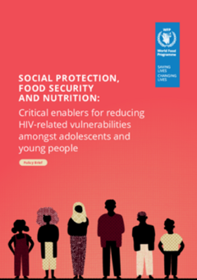
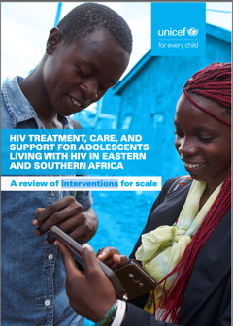

Slide 5





ACCELERATORS FOR HIV-PREVENTION
Zimbabwe VACS, n=7912 girls Mchenga et al 2024
Relative percentage change
Absolute change
100
90
80
70
60
50
40
30
20
10
0
30%
36.3 | → | 25.4
23.1 | → | 16.8
8.2 | → | 4.6
18.1 | → | 8.8
6.1 | → | 1.8
5.5 | → | 0.8
4.6 | → | 1.5
13.7 | → | 2.1
2.7 | → | 1.2
25.5 | → | 7.4
46.7 | → | 42.0
Inconsistent condom use or don’t know HIV status
Age-disparate or transactional sex
Early sexual debut (<16) or early pregnancy (<20)
Child marriage (before age 18, lifetime)
Sexual violence
IPV (physical)
Peer violence (physical)
Child abuse (physical or emotional)
Heavy alcohol use
Mental health distress
Not in school or paid work
Food security
27%
44%
51%
Positive
gender norms
70%
85%
67%
Good parenting
85%
56%
71%
10%
Mchenga, Hertzog, Toska, Banougnin, Dzumbunu, Yates, Cluver et al. paper under progress.
Modelled marginal effects accounting for covariates
Notes:
All variables are significantly associated with at least one accelerator.

Slide 6
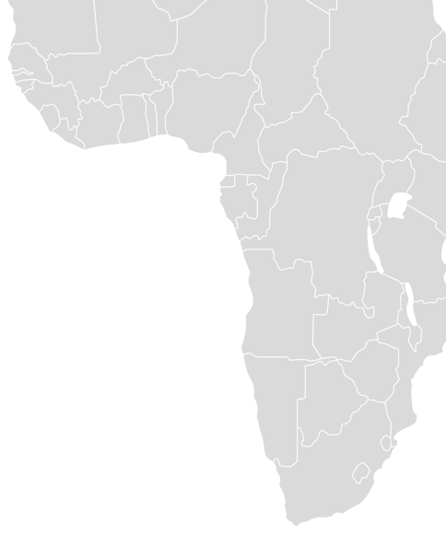



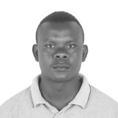





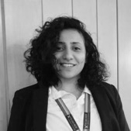



A NEW ECONOMIC APPROACH
Taking evidence to scale
6

Slide 7

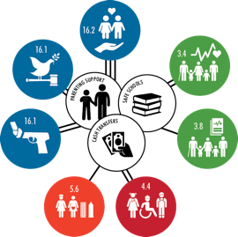








IDENTIFYING ACCELERATORS FOR INVESTMENT
For adolescent girls in Africa
12
Emerging 'Accelerator' Interventions
Child priorities
+240
Peer-reviewed publications since 2019
+20
Countries across the continent
South Africa
Kenya
No Abuse
+51%
School progression
+5.8%
Early marriage
-50.4%
No community violence
+20%
Good mental health
+33%
School enrolment
+17.8%
Adolescent birth rate*
-51.4%
No violence perpetration
+34%
HIV care retention
+22%
SRH education
Equal access to education
+6.7%
No high-risk sex
+19%
School progression
+34%
Cluver, Orkin, Toska, Campeau, Webb, Carlqvist, Sherr (2019).

Slide 8



REVIEWS OF HIGH-QUALITY EVALUATIONS
Adolescent-friendly health services | Cash transfers | Parenting programs
Overview of published reviews using keyword search (P: Adolescents; I: SRHR; O: Contraception use) Complemented with five key informant interviews, snowballing of reference lists | Review of a comprehensive review of non-contributory social protection and adolescents published in 2021 Complemented with follow-up searches in Google Scholar and Pubmed, and snowballing of reference lists | Review of a systematic review of parenting support programmes published in 2023 Complemented with three informant interviews, and snowballing of reference lists
Screened: 9 systematic reviews Full-text review: 143 articles Included: 10 evaluations (3 in Kenya) | Screened: 85 evaluations Full-text review: 20 evaluations Included: 7 evaluations (7 in Kenya) | Screened: 131 articles Full-text review: 8 articles Included: 2 evaluations (0 in Kenya)
Adolescent-friendly health services
Social protection
Parenting programs

Slide 9
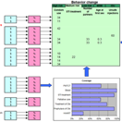
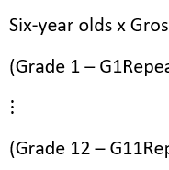
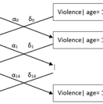
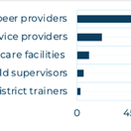
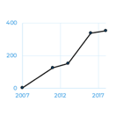
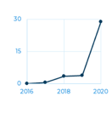
ECONOMIC MODELLING METHODS
Mathematical and economic modelling
Cost and Implementation data
Avenir Health’s Spectrum Model
Education transition model
Own peer-reviewed violence model
Uganda AYA Resourcing
Tanzania Furaha Teen growth
Kenya CT-OVC growth
Rudgard, Desmond et al., 2024. Social Sciences Repository Network
9
Notes:
There are two additional steps in order to model the impacts, cost and returns of structural interventions.
First we have to collect data on intervention resourcing, and, if programmes are already implemented by governments or NGOs, information on recent growth trajectories in the numbers of beneficiaries.
Second, we have to combine our effect estimate data, with our resourcing data, and country sociodemographics in health impact, education transition, and violence models.

Slide 10



ANALYTICAL FRAMEWORK FOR CALCULATING COMBINED IMPACTS ACROSS OUTCOMES
Cash transfer
Parenting programs
Adolescent
SRHR
Accelerator interventions
Enhanced household economic security
Supportive adolescent-caregiver relationship
Access to SRHR knowledge and services
Asset-based resources
Better education
Years of schooling gained
Violence prevention
Cases of emotional physical and sexual violence averted
Health promotion
Cases of HIV averted
Adolescent pregnancies averted
Lower child marriage
Health & wellbeing outcomes
10

Slide 11
HIGH RETURNS ON INVESTMENT
Across HIV, health, violence prevention and economic productivity
5920 fewer
child marriages
Economic strengthening
195,000 more
years of schooling
30,500 more
years of schooling
120,000 fewer
adolescent pregnancies
Adolescent-friendly health services
Example of Kenya
Investing $234 million over
10 years in girls aged 10-18
1035 evaluations
Government cost data
Decision analytic economic models
2660 fewer
cases of HIV infection
8510 fewer
cases of sexual violence
Parenting
program
54,400 fewer
cases of emotional
& physical violence
$886 million return
from increased labour market productivity
11

Slide 12
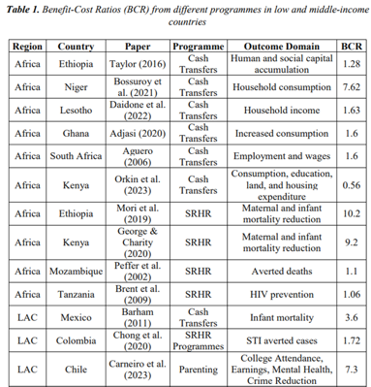
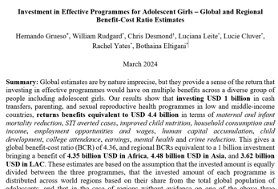

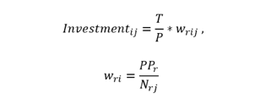
GLOBAL ESTIMATES
Methods
Estimates based on evidence from 28 cost-benefit analyses, after reviewing 943 evaluations
Methodological assumptions
Invested amount is equally divided between the three programmes
Invested amount in each programme is distributed across world regions based on their share of the global adolescent population, and
We sum up the multiplication between all available benefit-cost ratios (BCR) and the allocated investment amount in each country.

Slide 13
GLOBAL RETURN ON INVESTMENT
Every $1 spent on
$3.99-$4.50 globally
Adolescent-friendly
SRH services
Cash transfers
Parenting programs
$6.24-$8.08 Africa
$3.21 Asia
$3.17 Latin America and the Caribbean
is expected to yield a return of
Investing USD 1 billion in these three interventions in low and middle-income countries returns benefits between USD 3.99 and 4.5 billion in terms of maternal and infant mortality reduction, STI averted cases, improved child nutrition, household consumption and income, employment opportunities and wages, schooling and human capital accumulation, child development, college attendance, earnings, reduced child marriage, mental health and crime reduction.
13
Grueso, Rudgard, Desmond, Leite, Bandyopadhyay, Eltigani, Obiesie, Yates, Cluver (2024).
Notes:
JANINA: TAG WILL TO UPDATE

Slide 14
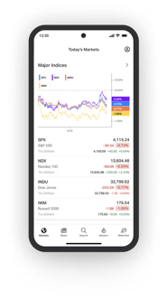



A NEXT GENERATION OF HIGH-IMPACT INVESTMENTS IN CHILDREN AND HIV
Adolescent-friendly health services
Social Protection
Gender norms change
Accelerator
Programs
Open-source combinations
Bang for buck
14

Slide 15


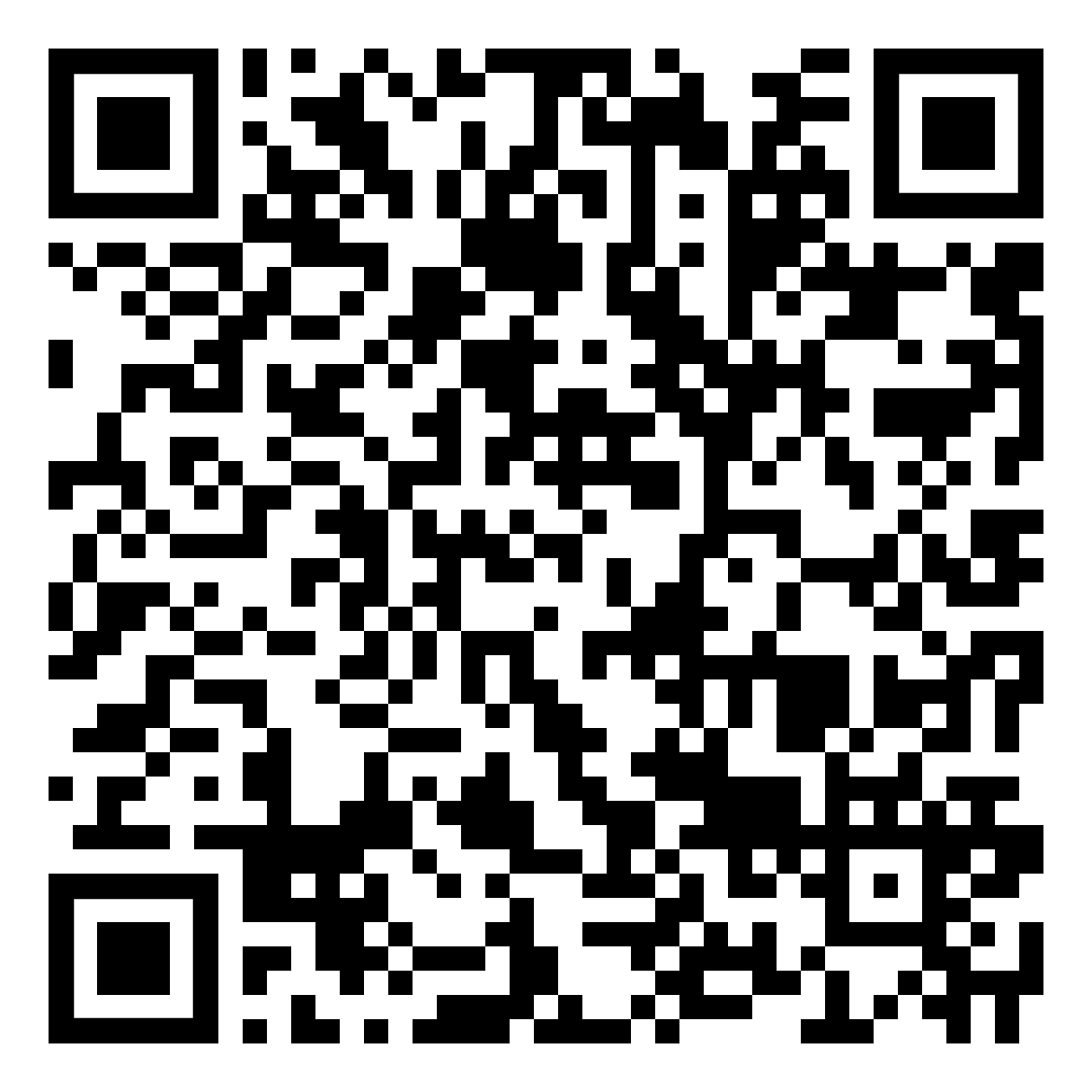





The Case for Rights-Based Investments in Adolescent Girls in Kenya: An Economic Modelling Study
Investment in Effective Programmes for Adolescent Girls – Global and Regional Benefit-Cost Ratio Estimates
Policy Brief: Right On The Money: Making the case for rights-based investments in adolescent girls (April 18, 2024).
Work led by
William Rudgard (University of Oxford), Chris Desmond (University of Witwatersrand), Hernando Grueso Hurtado (University of Oxford), Sopuruchukwu Obiesie (University of Oxford), Ritapriya Bandyopadhyay (University of Oxford), Broline Sagini Asuma (University of Oxford), Kathyrn Grace Watt (University of KwaZulu-Natal), Luciana Leite (University of Oxford), Rachel Yates (University of Cape Town, University of Oxford), Elona Toska, (University of Cape Town), Lorraine Sherr (University College London) Lucie Cluver (University of Oxford, University of Cape Town)
With thanks to
John Stover (Avenir Health), Ruth Graham-Goulder, Elena Camilletti, and the Multisectoral Working Group (UNICEF), Caroline Kabiru and Anthony Ajayi (APHRC), Karen Austrian and Miriam Temin (Population Council), Laurie Gulaid, Alice Armstrong, Emmanuelle Compingt, and Chiedza Chinakwetu (UNICEF ESARO), Kavutha Mutuvi, Sandra Simbiri, Mahboob Ahmed Bajwa, and Gloria Kaberia (UNICEF Kenya), Charlotte Watts and Michelle Remme (FCDO/LSHTM and Global Fund), Simon Halvey (Cornerstone and University of Witwatersrand), Brendan Maughan-Brown (University of Cape Town), Jamie Lachman and Jenny Doubt (University of Oxford)
With thanks to all the U Report respondents who shared their views and priorities.
We are also grateful for support from a family foundation that wishes to remain anonymous

